Slide 1
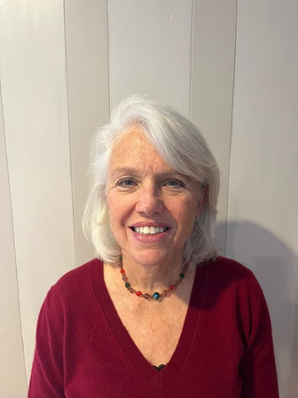




FREE SERVICE!
THE BENEFITS OF WORKING WITH AN
EAP COUNSELOR
Telehealth or In-Person Visits
Areas of focus include:
Managing stress and anxiety; building good coping strategies.
Improving family relationships; including parenting of young children and teens.
Understanding what is typical vs atypical related to anxiety and depression.
Improving sleep hygiene.
Addressing work stress and how to prevent burnout.
CHRIS RUMA-CULLEN, LISW-S
All Eaton employees, spouses, and dependents with parent permission are eligible
Located inside the Eaton Health Center
AVAILABLE HOURS:
Thursdays 12-5 pm
SCHEDULE AT
440-523-3100
OR ONLINE AT
mypremisehealth.com

